Slide 1
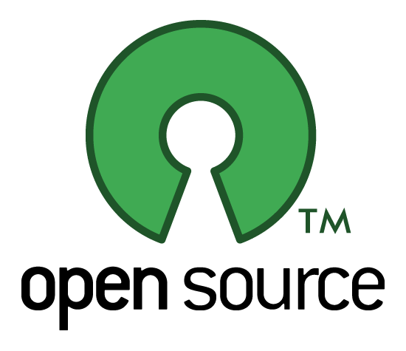
Sudheesh Singanamalla

Slide 2
What is Open Source ?
Editable and Free
Trustable
High impact
Every open source software is free to download and use for a lifetime. At the same time it gives the transparency to see whats happening behind the working of the software.
Open source applications are highly trustable with regards to the way in which the applications are made. They respect privacy and are built by people sharing the same vision
The best open source software are directly used by many large companies and industries because of its expertise in engineering. Many other users could also be using that software on a daily basis.

Slide 3
Why Open Source ?
Privacy is a major concern for anybody on the internet, you never know what information the software that you’re currently using in your phone actually knows about you. Its probably sending more information to trackers than you really know. Open source defends your privacy
Conventional software which are not open source could be “Freeware” or “Shareware” or “Paid”, these software are given to you for a limited amount of time as a trial or with limited features and you’re expected to pay them for the complete version.
Open source is actually good for your pocket.

Slide 4


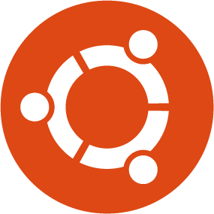



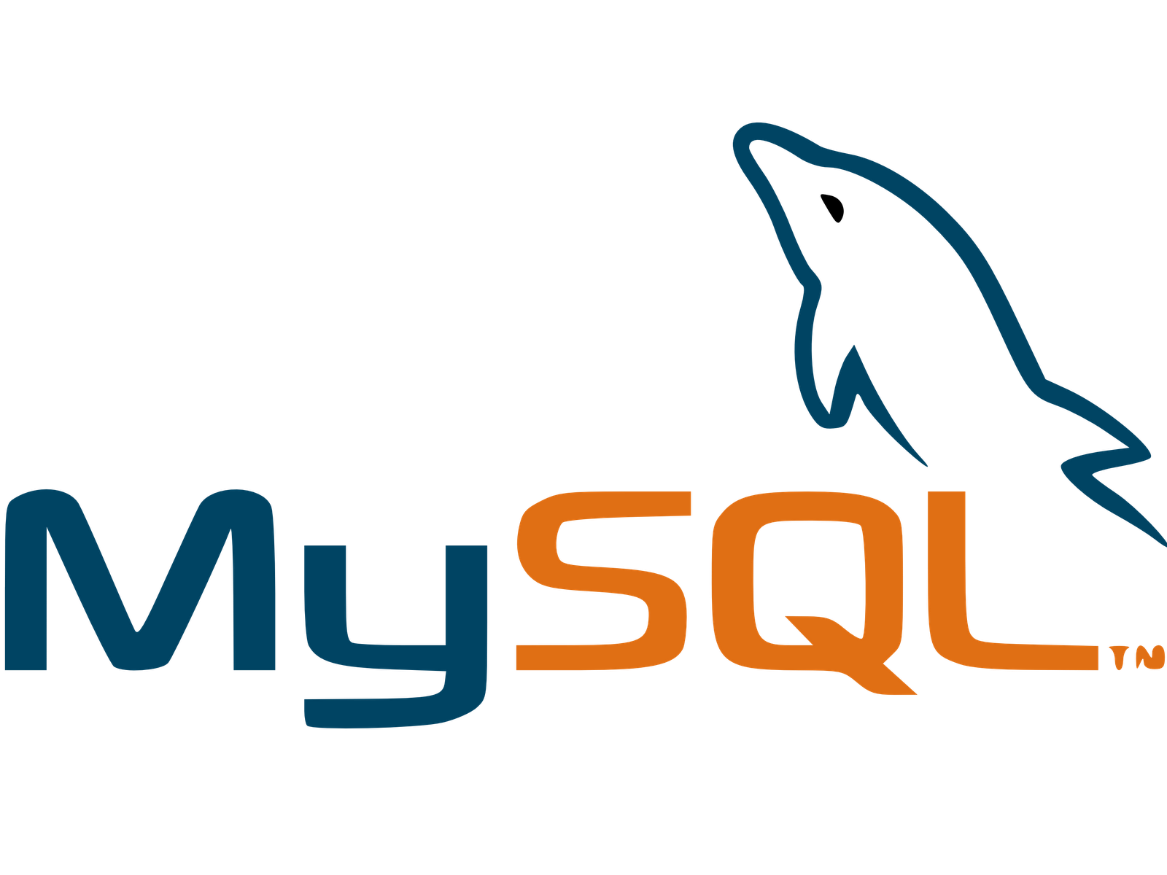




Some open source tools you might be using on a daily basis.
Open source applications are present everywhere from photography and editing applications, browsers, Office applications, operating systems, engineering applications and even the cloud where you have your emails.
You rely on them for your daily working.
You know many others who actually use the same software as you do.
They keep getting updated with newer features that you like or sometimes they give the users a feedback form asking for features.

Slide 5
Advantages of Open Source to you.
It can help you land in an amazing job and get noticed by the best companies.
It gives an excellent learning opportunity where you can stay up to date and learn from some of the industry best
It keeps you secure on the internet and keeps you aware of what data you’re sending to someone.
You can create an impact on the lives of many others by contributing code to the product of your choice.

Slide 6
The impact. (roughly)
12 highly advanced engineering software released everyday.
The open source market.
600 million+
Linux & UNIX users
Open source software generally have a mission and a vision statement to which the software product is dedicated to, it could be
To get more people to use the internet
To keep the internet open from dominance by only one company or a group of companies.
To revolutionize the engineering practices and tools.
To create software that communities can use freely.
900 Million
Android
users
Making internet a transparent and an open place which respects your freedom.

Slide 7


An opportunity to experiment
You might have a wonderful idea about some new technology that you wanted to build and you believe its possible. Open sourcing the application or the architecture behind it could potentially result in many research papers being published in the field and takes the technology forward.
Open source organizations are also open to new experiments as long as they align with their mission and vision statements. Optimizing existing resources from them itself could be a large task.
Replicant

Slide 8
The learning experience.
2014+
The year where there are hundreds of software engineers to choose from but none good enough to fit the roles, thus jobs not being filled and more unemployed people.
Person 1
Person 2
Person 4
Person 7
Person 3
Person 5
Person 6

Slide 9
Choosing your organization
Find out the list of open source software that you regularly use, either in your work or in your class or for on a day to day basis.
Do you have any complaints about it ? Do you want to change something about it ?
Then do it !!
Learn
Learn what they are upto
Indicate your interest and clearly document the details to them
Take up one of their projects under a mentor they’ll assign and work to fix it.
Interact
Enhance

Slide 10
Steps to contributing
Code Base
Understanding
Submitting
&
Reviews
Impacted
&
Merged
The first step to contributing to any open source organization once you’ve decided on it, is to know the programming languages involved and download the code for the particular software
The second step that’s involved is understanding the code base, picking a particular “bug” to solve and taking help from your mentor after putting in effort from your side.
Every change you make which needs to be accepted will be reviewed by the main engineers in the company / volunteers who are committers to the projects.
Once the review is positive, you have successfully fixed a problem and have made an impact to the project in whatever small way you could.

Slide 11
Time investment
Learning Curve 60%
20% Finding problems to fix
Pretty High
Effort and gaining experience
10%
10%
Interacting and talking to developers

Slide 12
Thank You !
twitter.com/sudheesh001
facebook.com/sudheesh001

